Slide 1
BOOKKEEPING
McGowan Accountancy Services 2023
McGowan Accountancy Services
Carrownabrickna
Gallowstown
Co. Roscommon
(090) 6625818 and (086) 0352849

Slide 2
BUSINESS BANK ACCOUNT
McGowan Accountancy Services 2023
It is very important that a business bank account is opened once the business commences. All sales should be lodged, and withdrawn to pay any business expenses. Expenses can be paid by direct debit. Once a PAYEE is set up, further payments to this PAYEE can be made more efficient and quickly.
A break down on the lodgements showing the source of each lodgement and listing which customer ( debtor) paid same.
I strongly suggest that all business expenses are paid directly from the business account.
If you are going to trade under a business name it is very important to register business name with CRO
A personal bank current account can be used until the business begins to make money. Some banks provide some perks for opening business accounts like free banking

Slide 3
Business Requirements
McGowan Accountancy Services 2023
Sales invoices or receipts should be given to all customers. Showing date, customer name and address, and the details of the work that was carried out. Invoices are required both by Social Welfare and Revenue. It is important that all customers both credit and cash sales customers are given receipts. As all income has to be included in the turnover figures Sales invoices can be issued from simple invoices, Word/Excel, invoices to go is app
All receipts for all business expenses need to kept and given to your accountant for the tax returns.
A excel sheet should be kept showing daily sales and list of purchases with back up documentation

Slide 4
DOCUMENTATION
McGowan Accountancy Services 2023
The big word in relation to business expenses is documentation, documentation. It is important that all documentation is kept, insurance policies, motor taxation, diesel. An expense that is paid by direct debits or cash need to be backed up with documentation/receipts
Do not forget to keep medical expenses, doctor and chemist as these can be claimed each year and for the last 4 years if these bills were not claimed before

Slide 5
Sales Invoices
McGowan Accountancy Services 2023
The following is required on all sales invoices
Your name or your business name
Your address
Your VAT number if applicable
date
Customers name and address
Description of work carried out or item sold
The amount chargeable for the Job, nett or nett and VAT included lets have a look at a sample of a invoice
n

Slide 6
Sample of Excel daily Sales and Expenses summary
McGowan Accountancy Services 2023
Daily Income and Expenditure
Date | Income
Expenditure
Date | Expenses | Diesel | Rent | Stationery | Rates | Purchases

Slide 7
Evidence of Registration s
McGowan Accountancy Services 2023

Slide 8
Evidence of Registration
McGowan Accountancy Services 2023
Social welfare will require copy of evidence of Registration.
When you are submitting all your documents for final approval to DSP this will need to be included
Back to work allowance will not be paid unless you can prove that there is evidence of Registration
You can register yourselves or get an agent to register you which usually takes about a week or so

Slide 9
EVIDENCE OF REGISTRATION WITH REVENUE COMMISSIONERS
McGowan Accountancy Services 2023
Social welfare requires evidence of registration with Revenue. Once registered with Revenue, there will be confirmation of the registration, and Social Welfare requires a copy of same.
If you become an employer it is important that you register as an employer. It is important that you give pay slips weekly to your employees. I suggest that you either do the wages yourself by using a payroll package or get a bureau to do the wages for you. As a RPN needs to be downloaded for each employee before the wages are complete. Also a PSR needs to be lodged with Revenue. There will be an automatic charge of €4,000.00 by Revenue if wages are not done correctly

Slide 10
Records that should be kept Cheques Journal - is a list of payments made from your bank account, this is required for each bank account Cash Receipts Book - is a list of all cash received and an explanation of where the funds have come from, for example, debtors, loan, etc Sales Day Book - Is a list of all sales invoices, the Sales Day Book should spilt the sales between the Vat and different types of product that you sell Purchases Day Book - Is a list of all purchase invoices. They need to be analysed into the cost of and expenses, and administration expenses
McGowan Accountancy Services 2023

Slide 11
List of Business Customers/SUPPLIERS
McGowan Accountancy Services 2023
A list of all business customers is required showing their address and telephone numbers. All invoices issued to the customer, credit notes issued, date the invoices were paid and the running balance or to show the account is cleared
A list of all business suppliers should also be kept showing name and address of suppliers, invoices and credit notes from suppliers and the date you paid the invoices and a running balance if any

Slide 12
Example of Business customers
McGowan Accountancy Services 2023
Customers as at 30th June 2022
ABC 2 €300.00
Paul Cox €600.00
Peter Frayne €300
Julia Stewart €500.00

Slide 13
EVIDENCE OF TRADING
McGowan Accountancy Services 2023
Social Welfare will carry out 3 months/9 month review and will require evidence of Trading. The following need to be available for review
Invoices
Receipts - to be given to customers when they pay their bills
Order books showing the order taken and paid and the orders for future work
Bank statements - both business and personal accounts
All records need to kept from the date the business commences to 3 months and 9 months respectively

Slide 14
EMPLOYEES
McGowan Accountancy Services 2023
It is important that a list of employees is kept, showing name and address of employees, commencement date of employment, and the amount of wages paid to each employee.
This information will be kept on the payroll package and will be very easy obtained.
It is very important that Contract of Employments are given to employees 5 days after commencement

Slide 15
Records that should be kept Sales Invoice - A copy of all sales invoices must be maintained Purchase Invoice – A copy of all invoices listed in your daybooks must be retained Stock Record - The type of records here depends on your business. This may be an area that should be discussed with your accountant Bank Statements - All bank statements from all your accounts should be maintained. All of the above records must be kept for seven years
McGowan Accountancy Services 2023

Slide 16
MENTORING AND MONITORING REVIEWS Social Welfare will carry out mentoring and monitoring reviews, at both 3 months and 9 months. The review forms will be completed and signed by the case officer and customer
McGowan Accountancy Services 2023

Slide 17
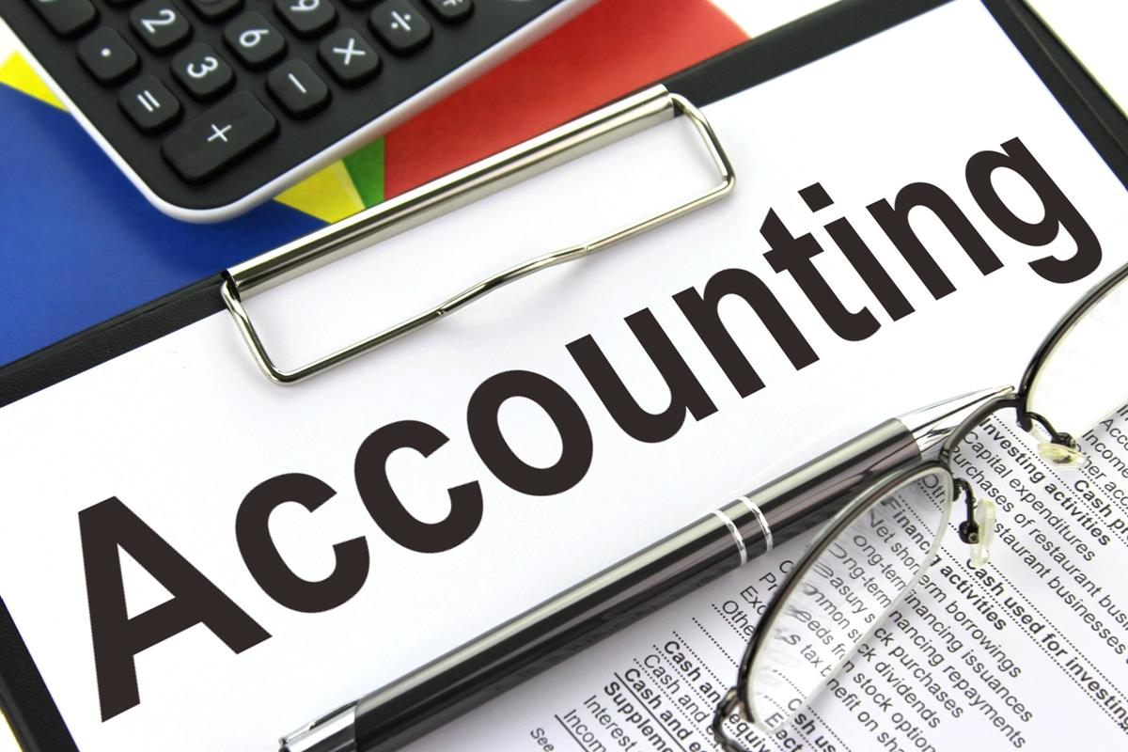
McGowan Accountancy Services 2023
This Photo by Unknown Author is licensed under CC BY-SA

Slide 18
Definition of Accounting
McGowan Accountancy Services 2023
Is the language of business. It assists in the evaluation of staff
Financial statements are the primary means of communication financial information to parties outside the business organization
Accounting uses the past in order to take action in the present and change the future

Slide 19
Accounting Definitions
McGowan Accountancy Services 2023
Asset is a resource with economic value that an business, owns or controls with the expectation that it will provide a future benefit, as a result of past transactions
Liability is something a person or company owes, usually a sum of money. Liabilities are settled over time through the transfer of economic benefits including money, goods, or services as a result of past transactions
Revenue is the income generated from normal business operations and includes discounts and deductions for returned merchandise.
Expense is the cost of operations that a company incurs to generate revenue. As the popular saying goes, “it costs money to make money.”

Slide 20
Accounting Definitions
McGowan Accountancy Services 2023
Debtor is someone that owes the business money for goods or services
Creditor is someone that the business owes money to for goods or services
Cash is the amount of cash in the business bank accounts and cash available
Inventories are partial and completed but unsold product
Plant and Equipment are factories and production machinery and tools that are required to enable the job be executed

Slide 21
Understanding Business Operations
McGowan Accountancy Services 2023
All business must have an accounting system that
Collects and processes financial information about the business
Reports information to decision makers
As it is a legal requirement

Slide 22
Difference between Financial and Management Accountant
McGowan Accountancy Services 2023
Financial Accounts Are required by laws, by the stake holders in the business. There is prescribed laws behind the format of the accounts The four basic financial statements are Statement of Cash flow Profit and Loss Account - income statement Balance sheet Statement of Retained Earnings | Management Accounts Prepared for managers to assist in the management of the business. There is no laws in relation to the format of the reports

Slide 23
Types of Business Ownership
McGowan Accountancy Services 2023
Sole Trader | Company | Partnership
Person sets up the Business on their own | One or more directors | 2 or more people
Unlimited Liability | limited liability | Unlimited liability
Can keep all the profits | Registers with Company Registration Office | Profit shared between the partners
Controlled by the owner | LTD private limited PLC Public limited trades on the stock exchange | Controlled by the partners

Slide 24
McGowan Accountancy Services 2023

Slide 25
Advantages of being Self-Employed
McGowan Accountancy Services 2023
Expenses for business purposes are deductible against your overall income for tax purposes
Flexible work days/hours
Ability to personally profit from increase in your own productivity and good ideas
Satisfaction and value of your own progress
Potential to earn a lot more money

Slide 26
Disadvantages of Being Self-Employed
McGowan Accountancy Services 2023
If your business fails it is more difficult to obtain social welfare as you will be means tested before being eligible to receive jobseekers allowance
Unpredictable Income
Potentially long working hours
Increased responsibility and pressure
Potential for loss
More paperwork

Slide 27
Registering a Business Name You may decide to use your own name as the business name. However if you wish to use a separate business name, then you must register same with the Companies Registration Office
McGowan Accountancy Services 2023

Slide 28
McGowan Accountancy Services Services 2023

Slide 29
McGowan Accountancy Services 2023
Registering as an Employer If you are employing or intending to employ staff. You are requested to register as an employer. Employers are required to deduct taxes from employee’s gross pay (PAYE, PRSI, and USC). The amounts deducted need to be paid to Revenue If you pay €8.00 per week (€36.00 per month) to an full time employee or per week ( €9.00 per month) you need to register as an employer. Since 1st January 2019 the Payroll system changed, RPN has replaced the P2C, a up to date RPN for each employee needs to be retrieved for each employee before you run your payroll. This ensures the correct credits and cut-off point for your employees is in operation. It is important that PSR is submitted to Revenue before the wages is paid each time there is a wages run.

Slide 30
McGowan Accountancy Services 2023
Contract of Employment Is a written contract between Employer and Employee which needs to be given to employee 2 months after commencement of employment As an employer you need to give part of this statement within 5 days of commencing employment to the employee

Slide 31
McGowan Accountancy Services 2023
A Contract of employment must include the following Terms that apply by law to every contract of employment ( duties of every employee to carry out the job ( for example the right to take maternity benefit) Right of an employee to join a trade union

Slide 32
What are the 5 core items that is required on statement within 5 days of commencing the employment ? The full name of the employer The full name of the employee The address of the employer The expected duration of the contract ( whether contract is fixed or temporary) What the employer reasonably expects the normal length of your working day
McGowan Accountancy Services 2023

Slide 33
This Photo by Unknown Author

Slide 34
Records that should be kept Sales Invoice - A copy of all sales invoices must be maintained Purchase Invoice – A copy of all invoices listed in your daybooks must be retained Stock Record - The type of records here depends on your business. This may be an area that should be discussed with your accountant Bank Statements - All bank statements from all your accounts should be maintained. All of the above records must be kept for seven years
McGowan Accountancy Services 2023

Slide 35
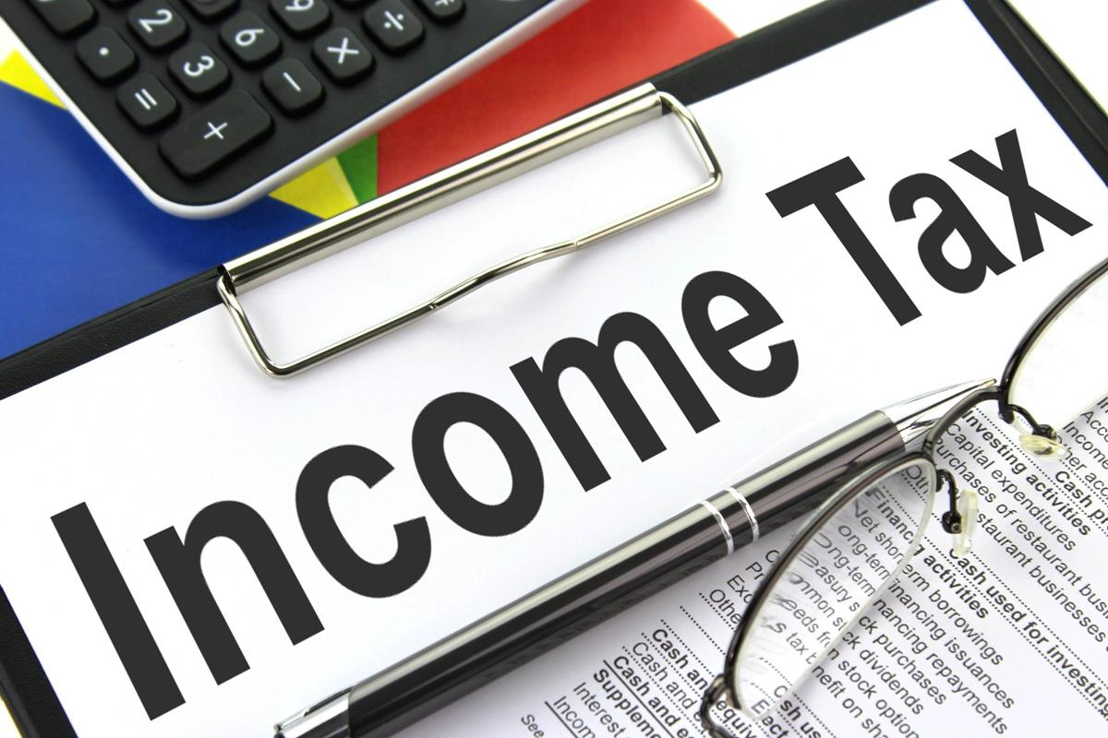
McGowan Accountancy Services 2023
This Photo by Unknown Author is licensed under CC BY-SA

Slide 36
INCOME TAX Individuals are required to register for income tax from the date of the commencement of the business. Registration can be completed online for all taxes through the Revenue Online System (ROS). You must register as a ROS customer to avail of the online service. This will allow you to file returns and make payments online for tax liabilities. Generally your accountant will complete this process on behalf of clients. When completing the registration for income tax, you will be required to choose an accounting year end date.
McGowan Accountancy Services 2023

Slide 37
Income Tax Rates Standard rate of income tax - 20% Higher rate of income tax - 40% USC 0.5% on the first €12,012 USC 2% on the next €8,675 USC 4.5% on the balance €29,313
McGowan Accountancy Services 2023

Slide 38
Preliminary Tax Preliminary tax is your estimate of income tax, that you expect to pay for the current tax year, calculated as follows: a. 100% of your previous year’s liability b. 90% of your current tax year liability c. 105% of your pre- preceding year’s liability Preliminary Tax
McGowan Accountancy Services 2023

Slide 39
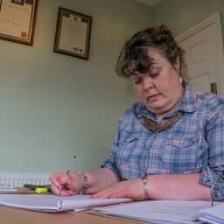
DO I NEED AN ACCOUNTANT ?
McGowan Accountancy Services 2023

Slide 40
Do I need an Accountant ? There is no legal requirement for a sole trader to engage an accountant or tax advisor. Registration for taxes and filing of tax returns can be completed by the business own if he/she is comfortable with the process and understands accounting and taxation systems and legal obligations and requirements. Sole trader accounts are not required to be signed off by a professional and statutory audits are not required. However, accounts are often required by third parties such as financial institutions, in relation to overdraft or loan applications. It is usually a requirement is that accounts are signed by a professional accountant. advisable to seek professional assistance in relation to taxation issues as the taxable system is complex. It allows the business owner to focus on his/her business rather than consuming the time with less familiar matters. Also professionals in this area will ensure compliance and assist with implementing tax efficient systems for business
McGowan Accountancy Services 2023

Slide 41
Money Laundering The process by which the proceeds of crime are processed. Accountants need to carry out AML procedures for all their clients. It is important that you ensure that your ID is kept up to date (driving licences and passports are current)
McGowan Accountancy Services 2023

Slide 42
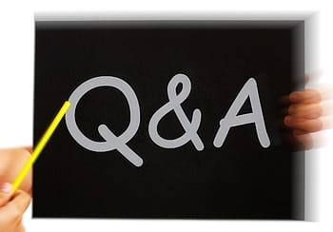
McGowan Accountancy Services 2023

